Slide 1
R & QGIS: Integrating Statistical and Spatial Data Analysis
Class 1: Spatial Data in R

Slide 2
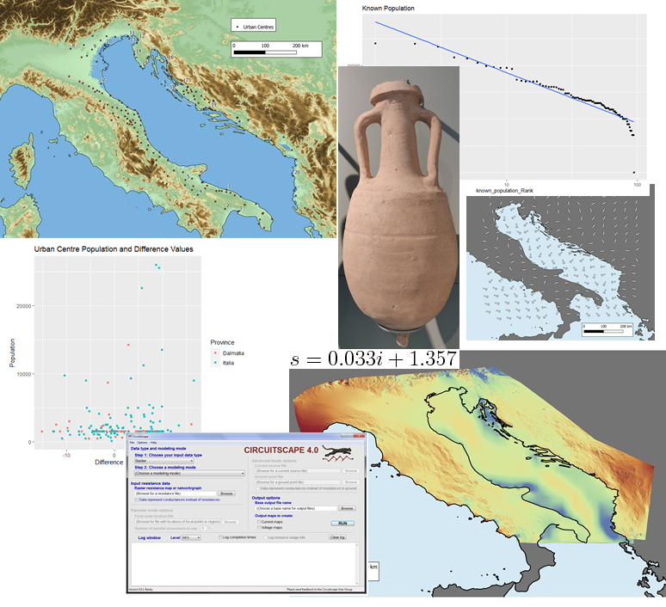

Before Starting…
Who am I
PhD candidate in Classics/Archaeology at the University of Edinburgh
Training Fellow with DCS

Slide 3
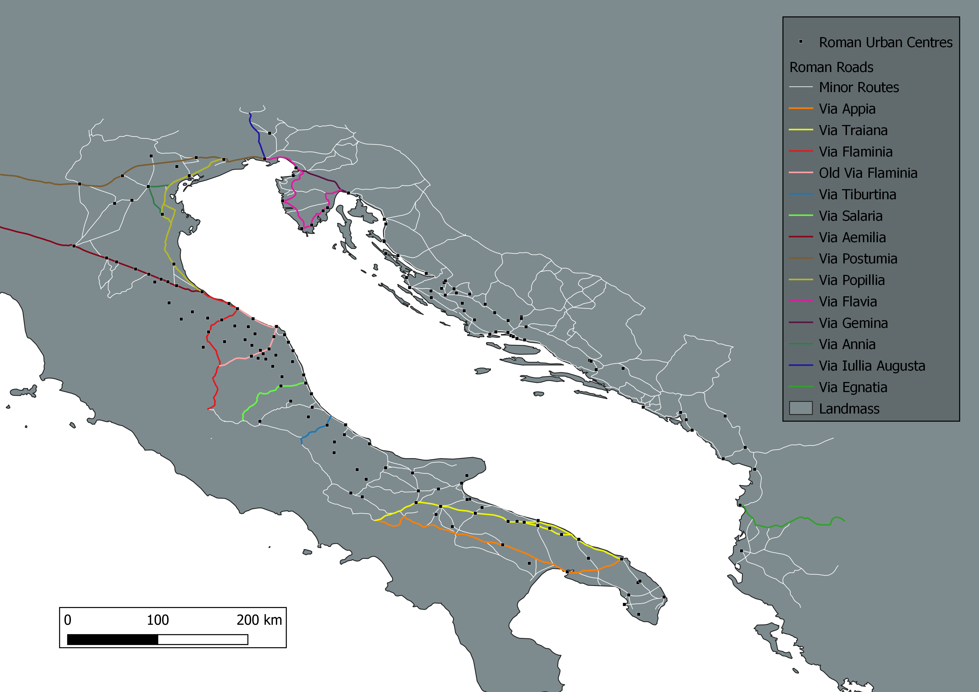
What is Spatial Data? Vectors
Generalised representation of the real world
Points, lines or polygons
Normally in .shp (shapefile) format
https://www.safe.com/what-is/spatial-data/

Slide 4
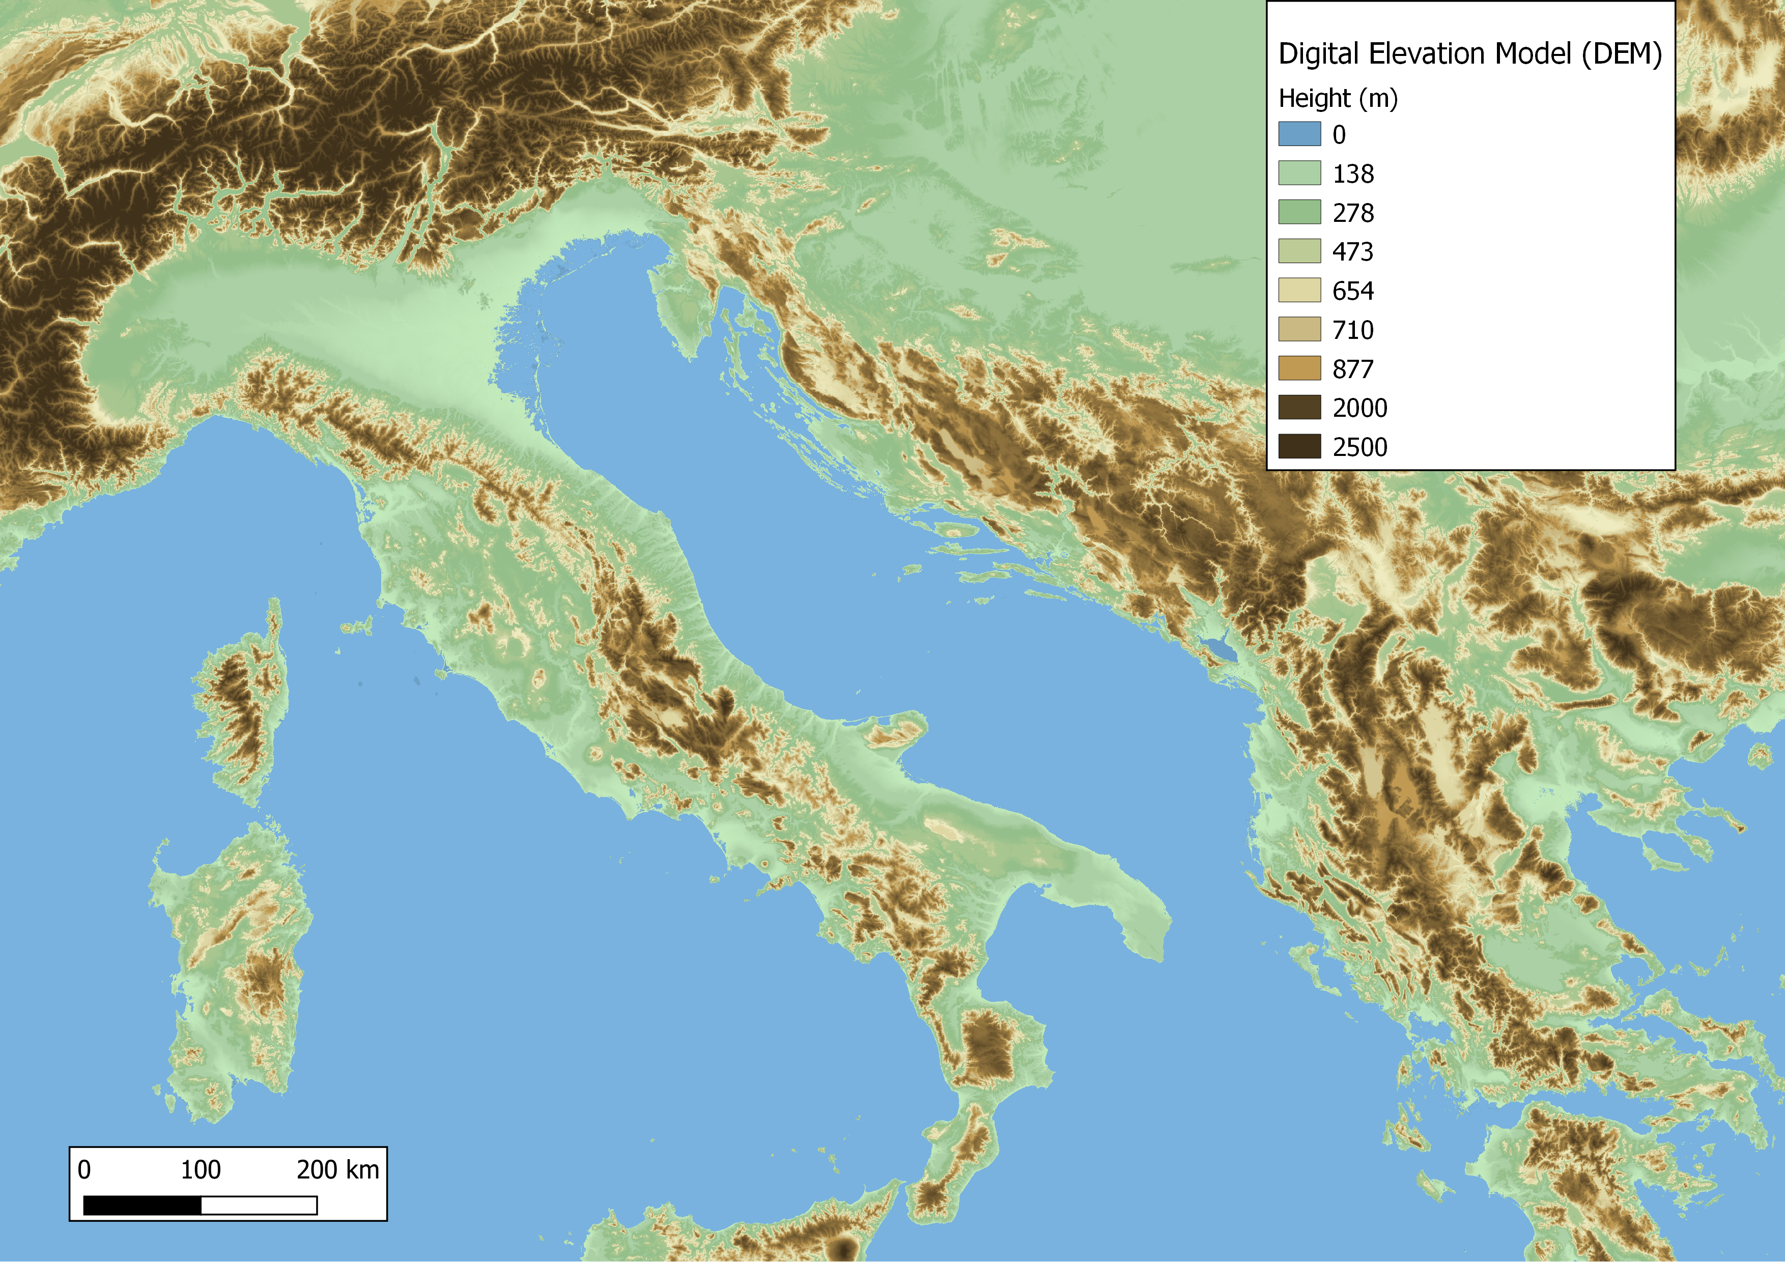
What is Spatial Data? Rasters
Grid of pixels, each with a value
Quality depends on resolution of pixels
Various formats, normally .tif
https://www.safe.com/what-is/spatial-data/

Slide 5
What is Spatial Data? Attributes
Any non-spatial information in that describes a feature
This is where spatial and statistical analysis can be integrated
https://www.safe.com/what-is/spatial-data/

Slide 6
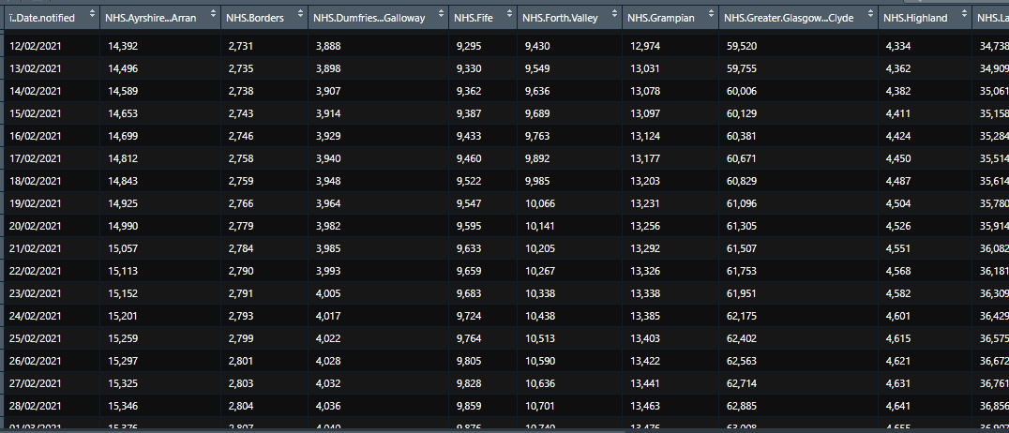
Spatial Data in R
Geospatial information is often included in statistical data, even if it is not the focus
But it can be plotted and used in R

Slide 7
Spatial Data in R
Take this generated income data as an example
set.seed(0)
xy <- cbind(x=runif(1000, 0, 100), y=runif(1000, 0, 100))
income <- (runif(1000) * abs((xy[,1] - 50) * (xy[,2] - 50))) / 500
plot(sort(income), col=rev(terrain.colors(1000)), pch=20, cex=.75, ylab='income')
hist(income, main='', col=rev(terrain.colors(10)), xlim=c(0,5), breaks=seq(0,5,0.5))
plot(xy, xlim=c(0,100), ylim=c(0,100), cex=income, col=rev(terrain.colors(50))[10*(income+1)])
https://www.rspatial.org/raster/analysis/2-scale_distance.html

Slide 8
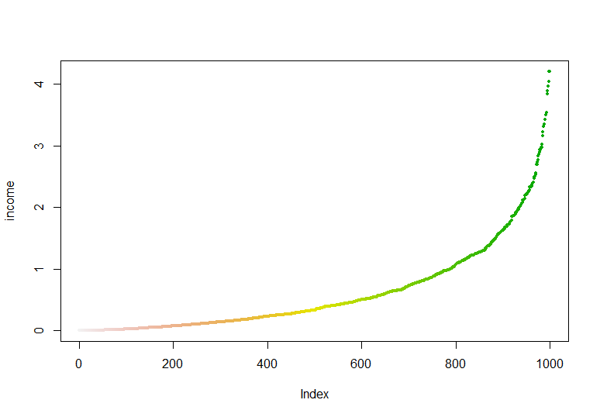
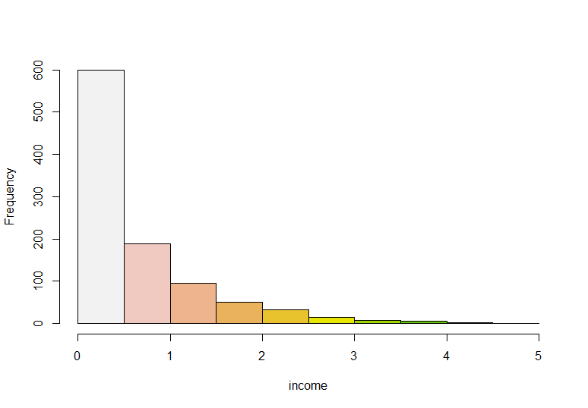
Spatial Data in R
Take this generated income data as an example
plot(sort(income), col=rev(terrain.colors(1000)), pch=20, cex=.75, ylab='income')
hist(income, main='', col=rev(terrain.colors(10)), xlim=c(0,5), breaks=seq(0,5,0.5))
https://www.rspatial.org/raster/analysis/2-scale_distance.html

Slide 9
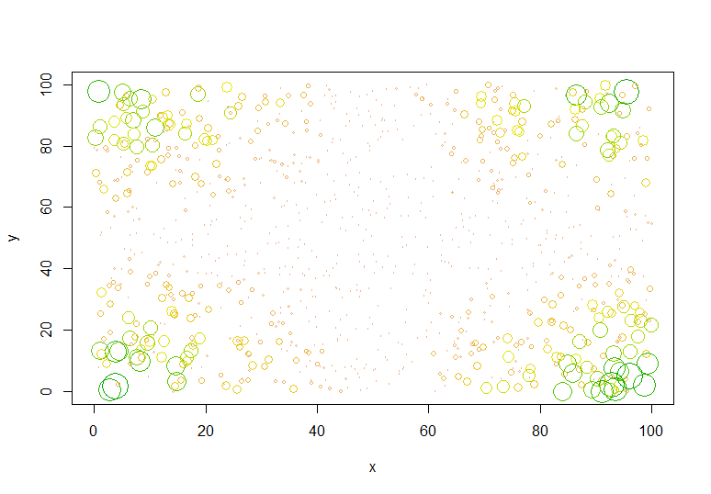
Spatial Data in R
Take this generated income data as an example
plot(xy, xlim=c(0,100), ylim=c(0,100), cex=income, col=rev(terrain.colors(50))[10*(income+1)])
https://www.rspatial.org/raster/analysis/2-scale_distance.html

Slide 10
Importing Spatial Data in R
Importing shapefiles requires some extra steps
Shapefiles are not exclusively the .shp, also include important information in .dbf, .shx etc.
The package ‘rgdal’ is the go to for working with shapefile data
Need to provide information on the directory in which the shapefile is in
(The ‘sf’ package (simple features) can be used to more straightforwardly import basic spatial data, but ‘rgdal’ and readOGR() work better with spplot)
install.packages("rgdal")
library(rgdal)
Read_csv("Data/Electoral/Election.Results.csv")
readOGR(dsn=path.expand("Data/Electoral/GIS"), layer="Constituencies")
install.packages(“sf")
library(sf)
read_sf("Data/Basic/Points.shp")

Slide 11
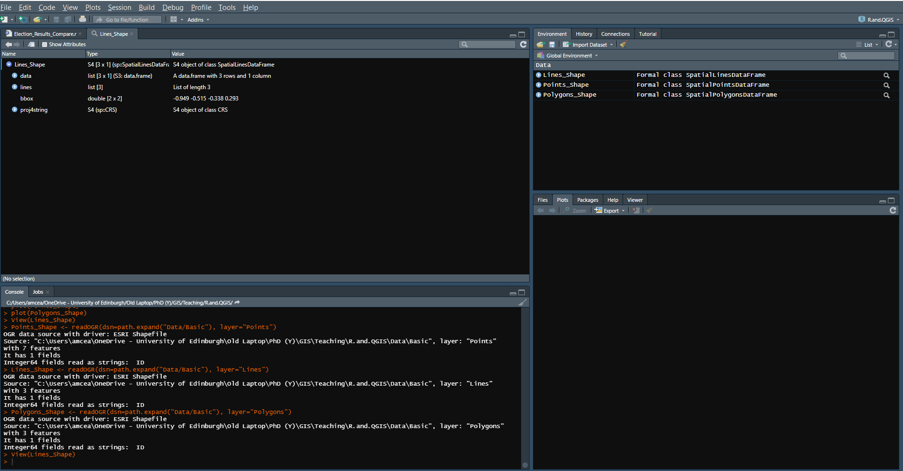
Importing Spatial Data in R
This process for importing spatial data is the same for any type of vector shapefile
Points_Shape <- readOGR(dsn=path.expand("Data/Class"), layer="Points")
Lines_Shape <- readOGR(dsn=path.expand("Data/Class"), layer="Lines")
Polygons_Shape <- readOGR(dsn=path.expand("Data/Class"), layer="Polygons")

Slide 12
Importing Spatial Data in R
Importing raster files is somewhat more straightforward
The package ‘raster’ or ‘terra’ are good tools for working with raster data
install.packages("raster")
library(raster)
raster("Data/Class/Raster/Swiss_Altitude.tif")
install.packages("terra")
library(terra)
rast(" Data/Class/Raster/Swiss_Altitude.tif")
https://arc2r.github.io/book/import_raster_raster.html

Slide 13
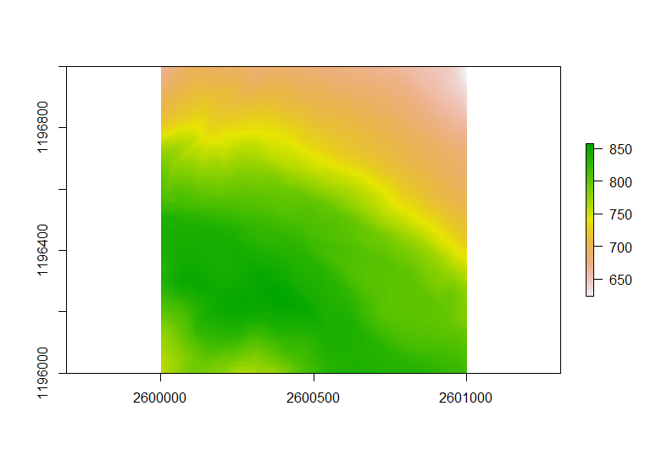
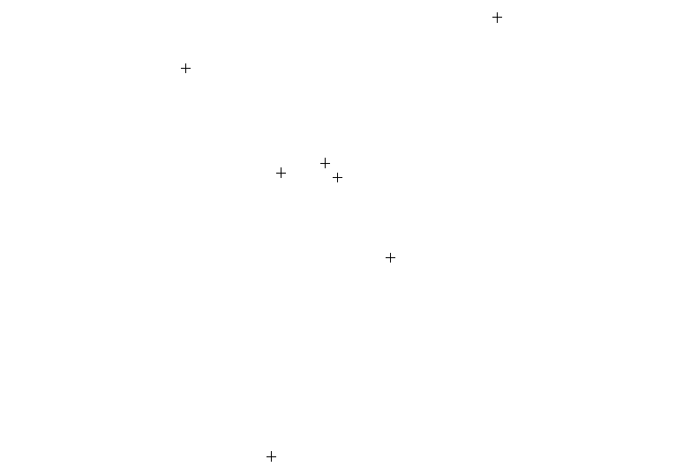
Plotting Simple Spatial Data in R
The R plot function can very easily plot most spatial data, in a very basic visualisation
The output will vary slightly depending on which package you used to import
Vector and Raster data are plotted in essentially the same way
plot(Points_Shape)
plot(Swiss_alt)

Slide 14
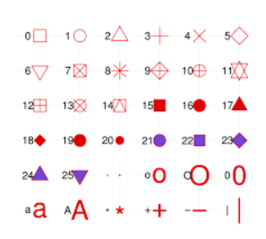
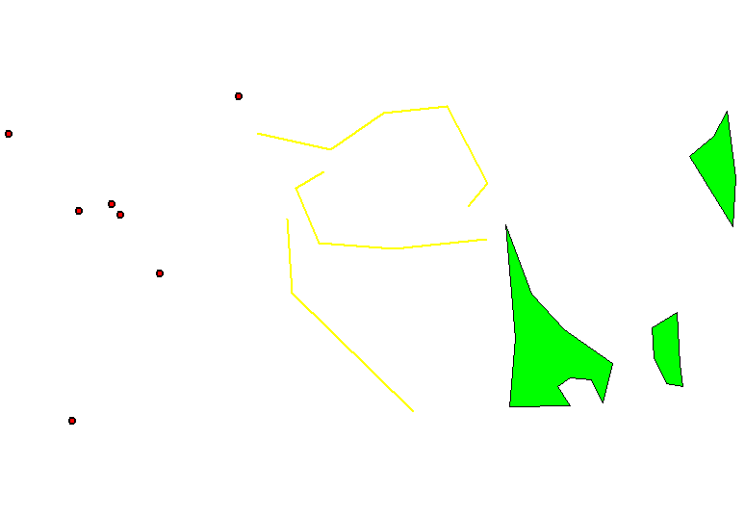
Plotting Simple Spatial Data in R
Plot can offer much more detail in plotting your spatial data
Par(mfrow) allows multiple plots to be visualised side by side. Pch, col, bg, cex and lwd all adjust the output visually
par(mfrow=c(1,3), las=1)
plot(Points_Shape, pch=21, col='black', bg='red', cex=1.75, lwd=2)
plot(Lines_Shape, col='yellow', lwd=2)
plot(Polygons_Shape, col='green', lwd=1.9)
https://r-lang.com/pch-in-r/

Slide 15
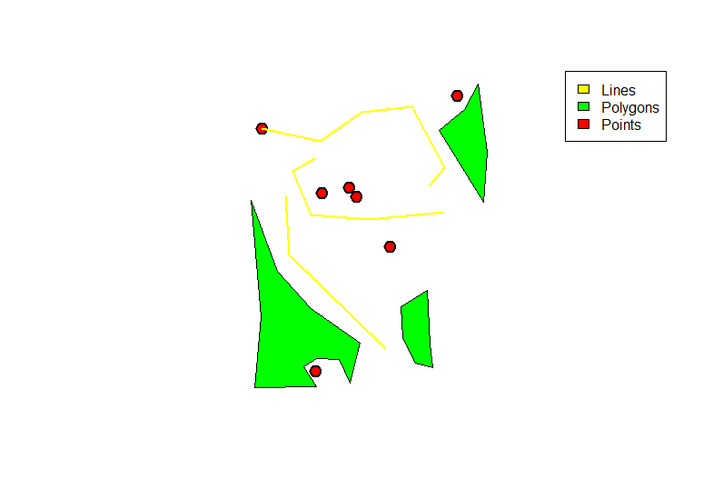
Plotting Simple Spatial Data in R
Using points and/or lines instead of plot allows stacking of shapefiles, and legend offers a legend
plot(Polygons_Shape, col='green', lwd=1.9)
points(Points_Shape, pch=21, col='black', bg='red', cex=1.75, lwd=2)
lines(Lines_Shape, col='yellow', lwd=2)
legend("topright", c("Lines", "Polygons", "Points"), col = c('yellow', 'green', 'red'),fill=c('yellow','green','red'))
Alternatively, use add=TRUE
plot(Polygons_Shape, col='green', lwd=1.9)
plot(Points_Shape, pch=21, col='black', bg='red', cex=1.75, lwd=2, add=TRUE)
plot(Lines_Shape, col='yellow', lwd=2, add=TRUE)

Slide 16
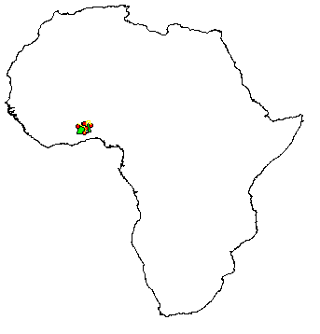
Understanding Spatial Data
The examples used so far are just shapes, unrecognisable as places in the output
However, they are tied to real physical space
Africa <- readOGR(dsn=path.expand("Data/Basic"), layer="Africa")
plot(Africa)
plot(Polygons_Shape, col='green', lwd=1, add=TRUE)
plot(Points_Shape, pch=21, col='black', bg='red', cex=0.75, lwd=1, add=TRUE)
plot(Lines_Shape, col='yellow', lwd=1, add=TRUE)
The CRS can be checked using st_crs()
st_crs(Africa)
The exact extent can be checked using st_crs()
extent(Africa)

Slide 17
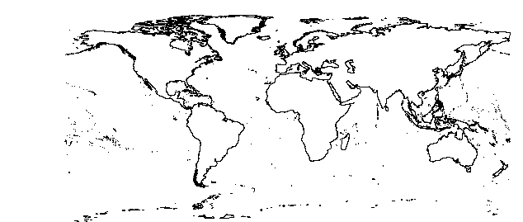
Understanding Spatial Data
The x and y limits of plots can be extended or shrunk with ‘xlim’ and ‘ylim’
plot(Africa, xlim=c(-180,180), ylim=c(-84,84))
plot(World, add=TRUE)

Slide 18
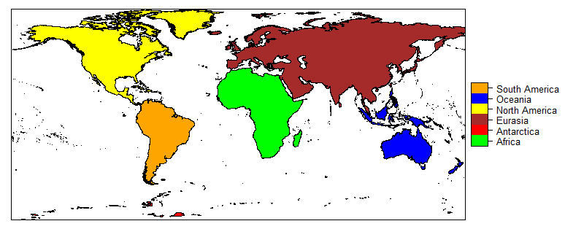
Spplot
Spplot allows for more nuance to working with spatialpolygon data in R
Attribute tables can more readily be used in visualisation
install.packages("sp")
library(sp)
spplot(World, col.regions=c("green","red","brown","yellow","blue","orange"))
See: https://www.rdocumentation.org/packages/sp/versions/1.4-5/topics/spplot

Slide 19
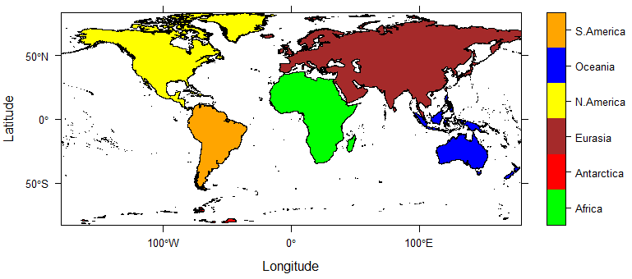
Spplot
Custom labels can be used
spplot(World, zcol='Continent', col.regions=c("green","red","brown","yellow","blue","orange"), scales=list(draw = TRUE), xlab='Longitude', ylab='Latitude', colorkey =list(labels=list(labels=c('Africa', 'Antarctica', 'Eurasia', 'N.America', 'Oceania', 'S.America'))))

Slide 20
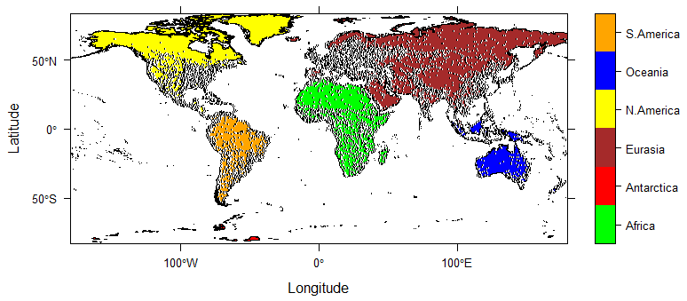
Combining Plots
Adding point data to an spplot() requires additional steps
The ‘latticeExtra’ package is required
Using the layer(panel.points) function, a panel with point data can be overlaid on a spatialpolygon
World_Plot+layer(panel.points(x=World_Cities$lng,y=World_Cities$lat, col="black", fill='white', pch=21, cex=0.3))
See: https://www.rdocumentation.org/packages/latticeExtra/versions/0.6-29/topics/layer

Slide 21
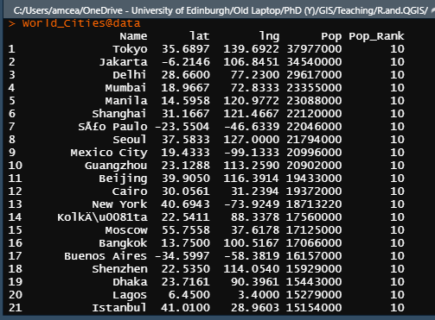
Using data in the Visualisation
The attributes of the shapefile can be viewed in the normal way-
Or to view the entire data table- World_Cities@data
World_Cities$Pop_Rank
World_Cities@data

Slide 22
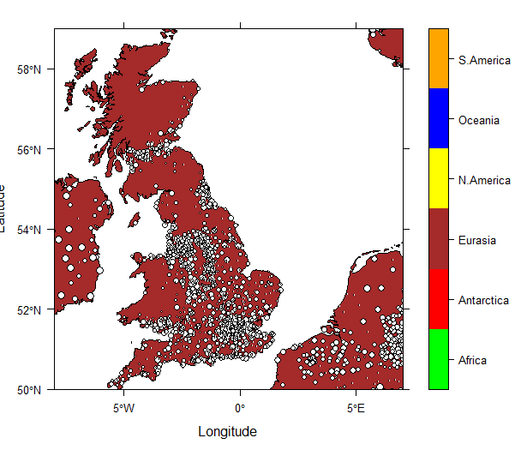
Using data in the Visualisation
We have seen how spatialpolygons can change colour based on their attributes
Spatialpoints can also be visualised based on attributes, in this example, the size of the point is based on population rank
(The extent has been reduced to allow for easier visualisation)
World_Plot_shrink+layer(panel.points(x=World_Cities$lng,y=World_Cities$lat, col="black", fill='white', pch=21, cex=as.numeric(World_Cities$Pop_Rank)/10, data=World_Cities))

Slide 23
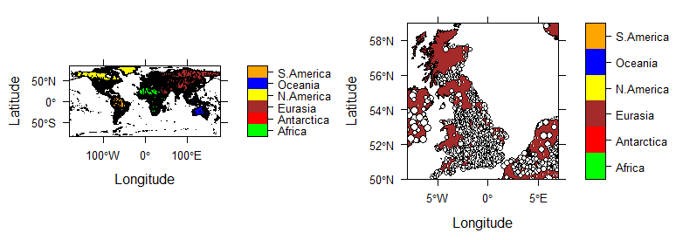
Using data in the Visualisation
Like in plot(), maps can not only be overlaid on top of one another, but displayed side by side
This requires the ‘gridExtra’ package to be used for spatialpolygon dataframes
grid.arrange(World_Plot+layer(panel.points(x=World_Cities$lng,y=World_Cities$lat, col="black", pch=21, cex=0.3)),World_Plot_shrink+layer(panel.points(x=World_Cities$lng,y=World_Cities$lat, col="black", fill='white', pch=21, cex=as.numeric(World_Cities$Pop_Rank)/10, data=World_Cities)),ncol=2)

Slide 24

There is much more to spatial data in R
Any questions?

